Slide 1
VARIABLES IN JS
Sai Vardhan T.

Slide 2
INTRODUCTION
Variables are the building blocks of any programming language, and JavaScript is no exception.
They allow you to store information that your code can use and manipulate.
Basic Rules while creating Javascript variables:
Must start with a letter, underscore (_), or dollar sign ($).
Can contain letters, numbers, underscores, and dollar signs.
Are case-sensitive (e.g., age is different from Age).
Cannot be reserved keywords in JavaScript (like var, function, if).

Slide 3

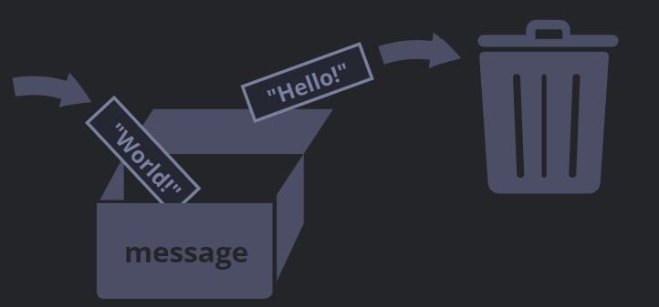
REAL LIFE ANOLOGY
We can easily grasp the concept of a “variable” if we imagine it as a “box” for data, with a uniquely-named sticker on it.
For instance, the variable message can be imagined as a box labelled "message" with the value "Hello!" in it:

Slide 4
TYPES OF DECLARATIONS
JavaScript Variables can be declared in 3 ways:
Using var
Using let
Using const

Slide 5
USING VAR
The var keyword was used in all JavaScript code from 1995 to 2015.
The var keyword should only be used in code written for older browsers.
var is function-scoped, meaning it's accessible within the function where it's declared.
It can be re-declared and updated.
SYNTAX:
var variable_name;

Slide 6
USING LET
let is block-scoped, meaning it's limited to the block (within curly braces) where it's defined.
It can be updated but not re-declared within the same scope.
SYNTAX:
let variable_name;

Slide 7
USING CONST
const is also block-scoped.
It cannot be updated or re-declared once initialized. However, for objects and arrays, the properties or elements inside them can be modified.
SYNTAX:
const variable_name;

Slide 8
NULL VARIABLE
In JavaScript, a variable can be assigned the value null, which represents the intentional absence of any object value. Here's how you can use null with variables:
SYNTAX:
var x = null;
let y = null;
const z = null

Slide 9
COMMENTS IN JS
Sai Vardhan T.

Slide 10
INTRODUCTION
Comments in JavaScript are used to annotate code, provide explanations, or temporarily disable code execution.
There are two main ways to write comments in JavaScript:
Single Line Comments
Multi Line Comments

Slide 11
SINGLE LINE COMMENTS
Single line comments start with // and extend to the end of the line:
SYNTAX:
//Hello How are You

Slide 12
MULTI LINE COMMENTS
Multi-line comments start with /* and end with */. They can span multiple lines:
SYNTAX:
/* HELLO
HOW
ARE
YOU */

